Slide 1
This is your EVS helpbook 2019
Kateryna Rodynenko

Slide 2
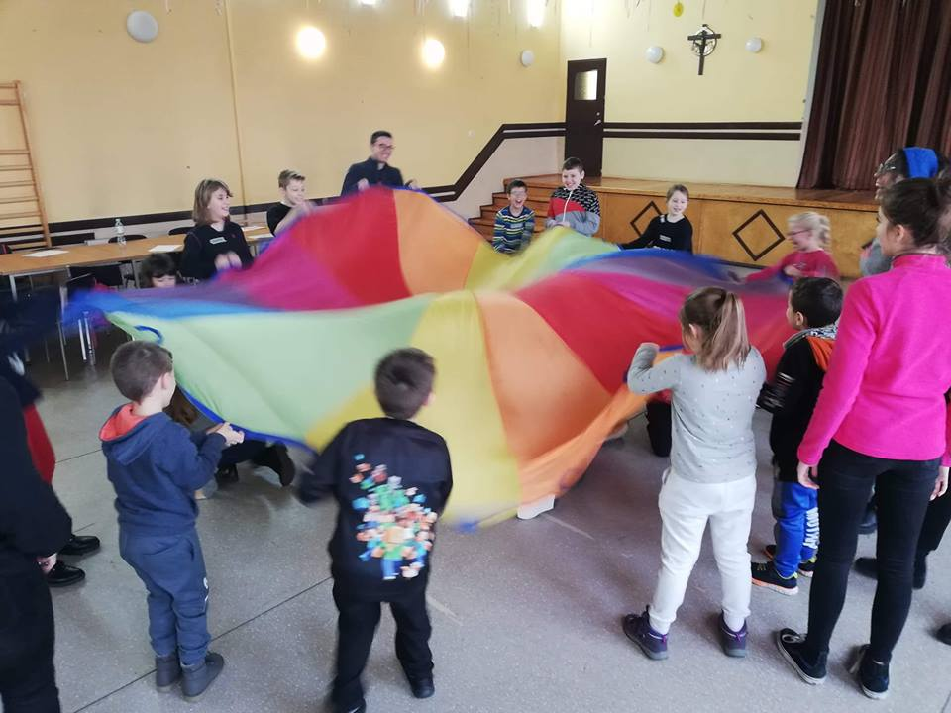
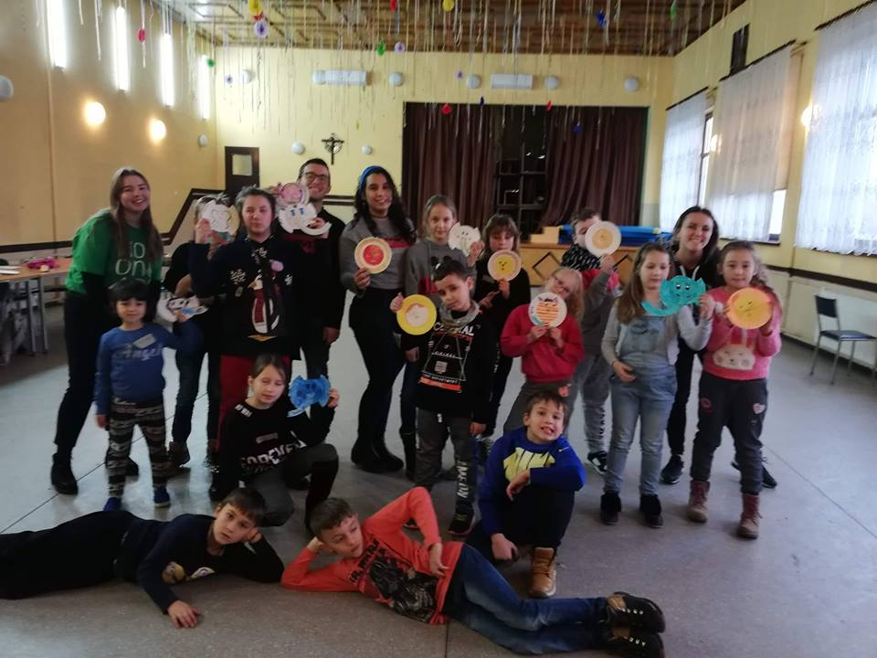
1. We do sport activities and games for children
Get to know the age of your working group
Search for ideas in Internet or ask long-terms if have doubts
Discuss ideas for your workshop with your partner
Come on time
Always feel free to ask teachers

Slide 3
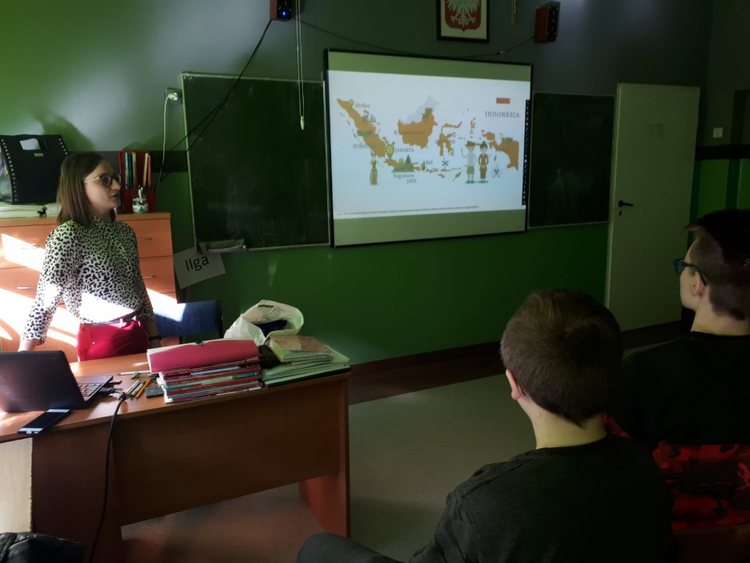
2. We present our countries
Check the most attractive places to see in your country
Add some personal places you like
Share your life-story

Slide 4
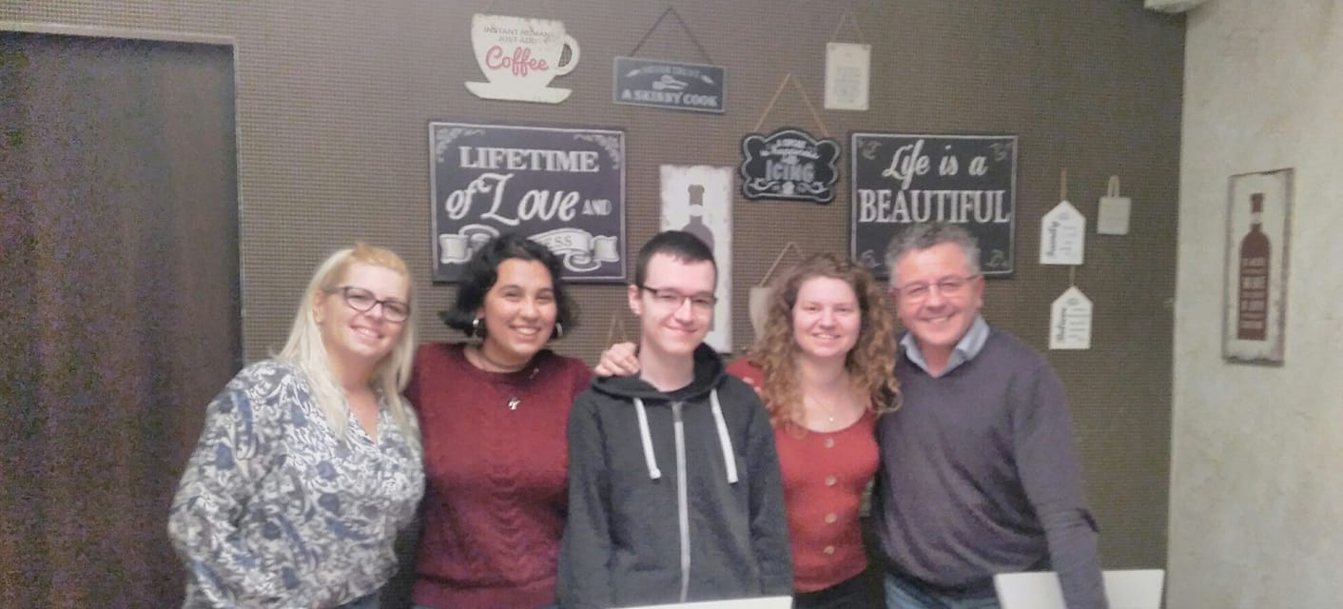
3. We speak English at
Language Café
Use your basic knowledge about general topics in English (sports, culture, family, tourism)
Play! Bring some table games or cards to learn more effectively
Talk! Even when you do not know what to say☺

Slide 5
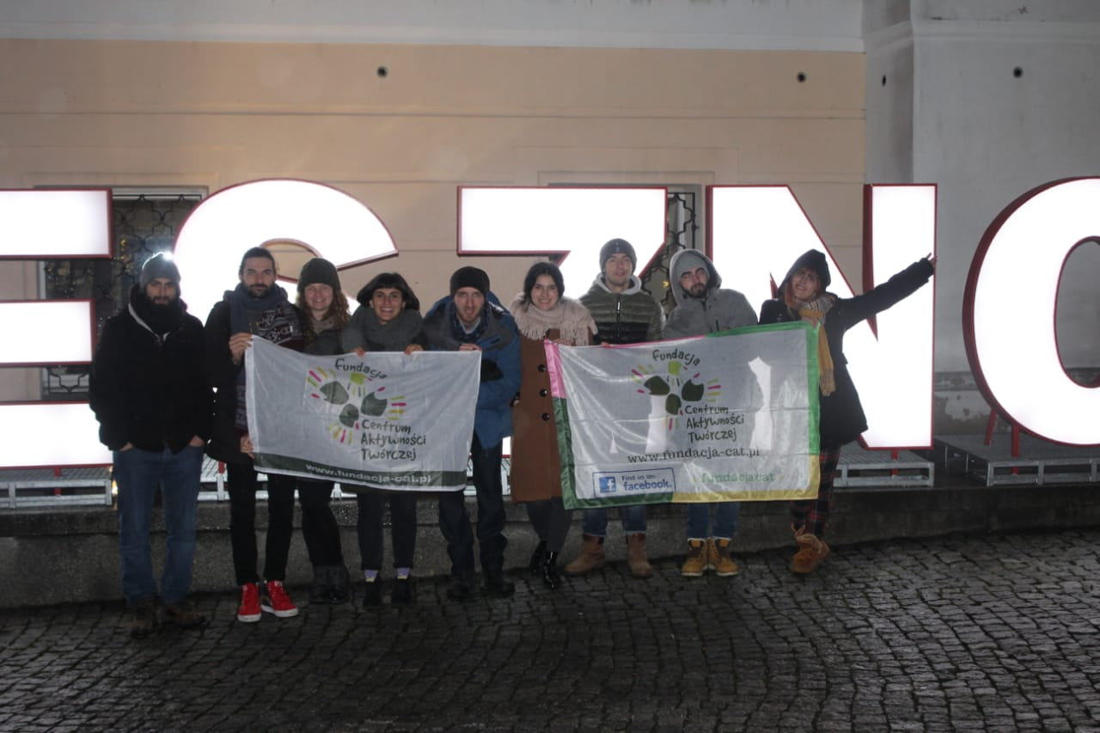
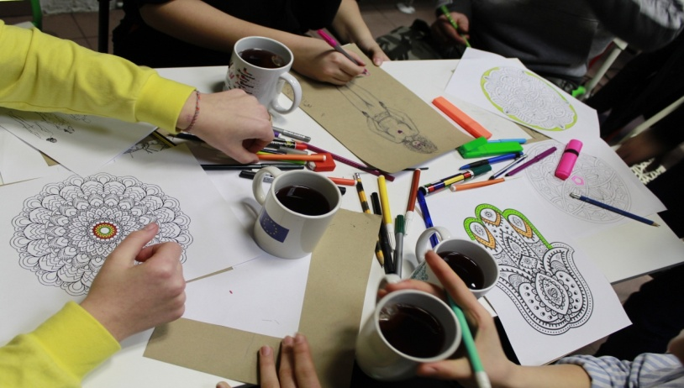
4. We spend time with locals, meet new people and integrate with internationals
Have positive vibes and be ready for a new adventure every day☺
Have fun!

Slide 6
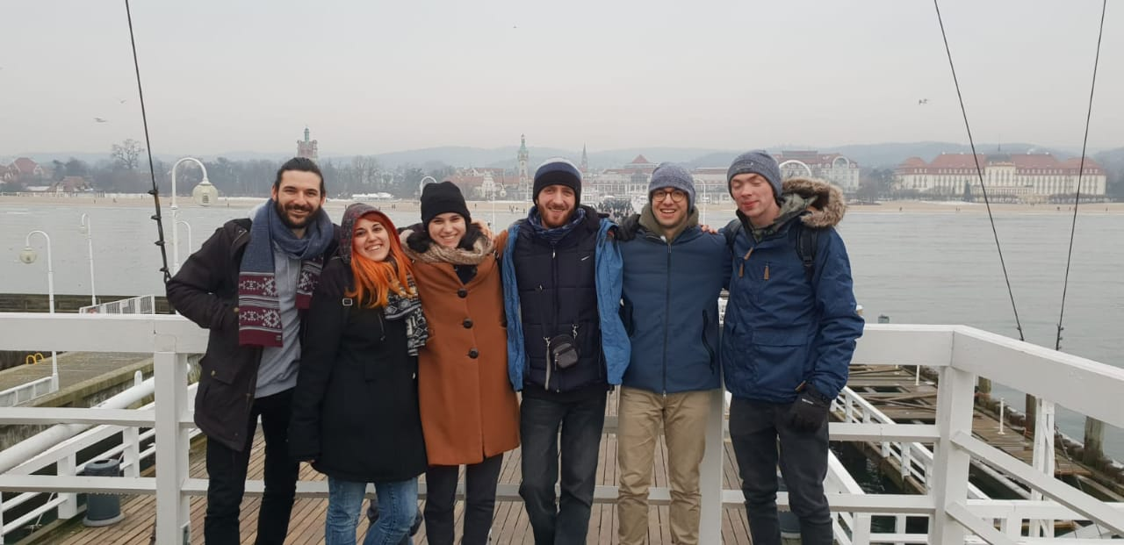
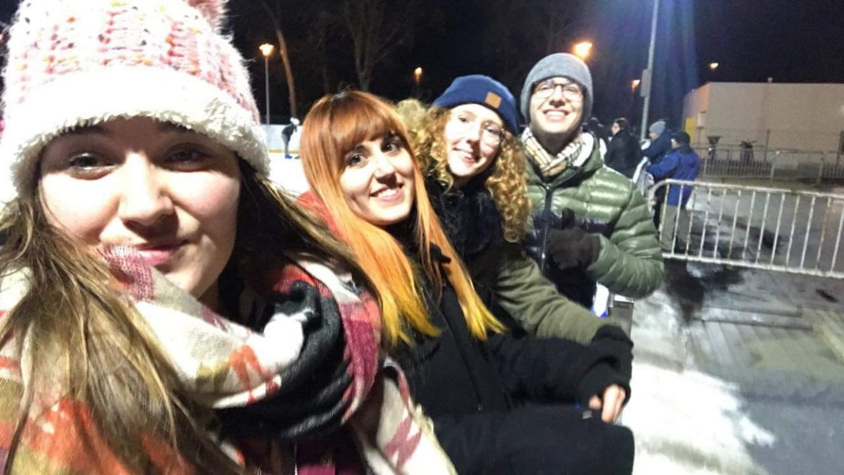
5. We travel a lot and discover new destinations
Take photos and a good mood
…and maybe warm clothes during winter
Do not choose MajorBus (the cheapest but not best one)!

Slide 7
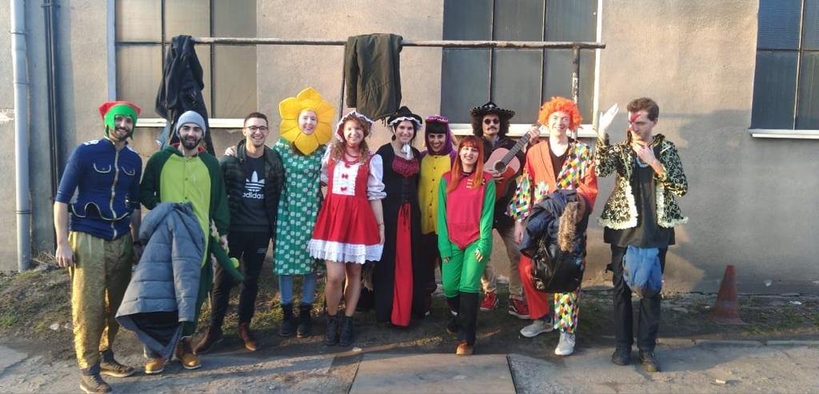
6. Eventually….like us, you will meet crazy and interesting people ☺

